Slide 3



Javier Menéndez Pallo
ENCAMINA
Director ENCAMINA Madrid
Doctor – Information Systems (PhD)
MCSE, MCSA, MCTS, MCITP, MCAD, MCSD, MCPS
http://blogs.encamina.com/everyware/
@JavierPallo

Slide 4



Alberto Diaz Martin
ENCAMINA
Principal Team Leader
SharePoint Server MVP
http://geeks.ms/blogs/adiazmartin
http://blogs.encamina.com/negocios-sharepoint
@adiazcan

Slide 5
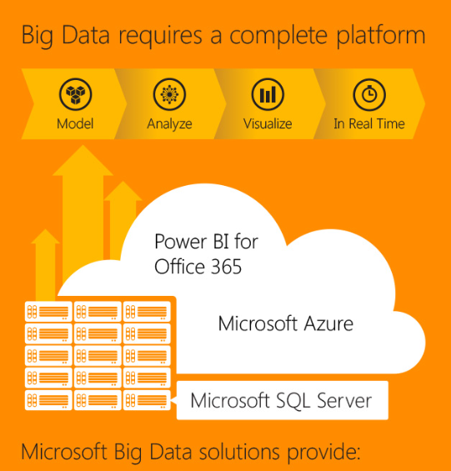
Microsoft Business Intelligence Stack

Slide 6


Microsoft Business Intelligence and Analytics
DELIVERY AND CONSUMPTION
Power BI
Dashboards
Reports
Excel
Mobile
APIs
BUSINESS ANALYST TOOLS
IT PRO AND DEVELOPMENT TOOLS
Excel
SQL Server Analysis Services
DATA
SQL Server Reporting Services
Power BI Designer
SQL Server Data Tools
Relational
Non-relational
NoSQL
ETL
Streaming
SaaS Services
Public
Machine Learning
{ }
10101
01010
00100

Slide 7
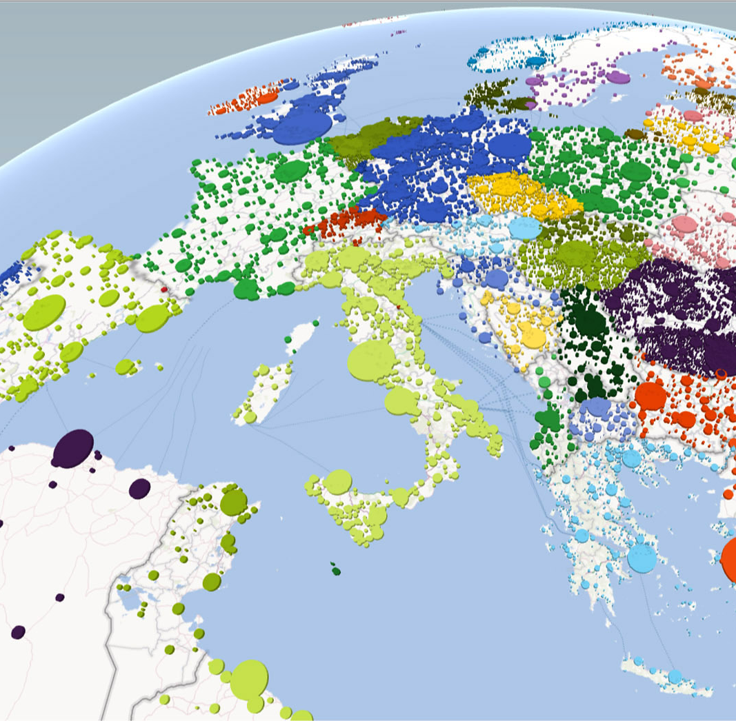
Power* PowerPivot PowerQuery PowerView PowerMap 0 lo que es lo mismo: la leche!

Slide 8
Excel

Slide 9
GO TO: http://1drv.ms/1FHNQxa Internet Sales.xlsx Recommended PivotTables DrillDown Charts

Slide 10
Natural Language Queries

Slide 11
Principales notas de Q&A

Slide 12
Data Visualization: Power View

Slide 13
Principales notas de powerview

Slide 14
Data Discovery: Power Query

Slide 15
Principales notas de powerquery

Slide 16
Data Modeling: Power Pivot

Slide 17
Principales notas de powerpivot

Slide 18
Geospatial : Power Map

Slide 19
Principales notas de powermap

Slide 20
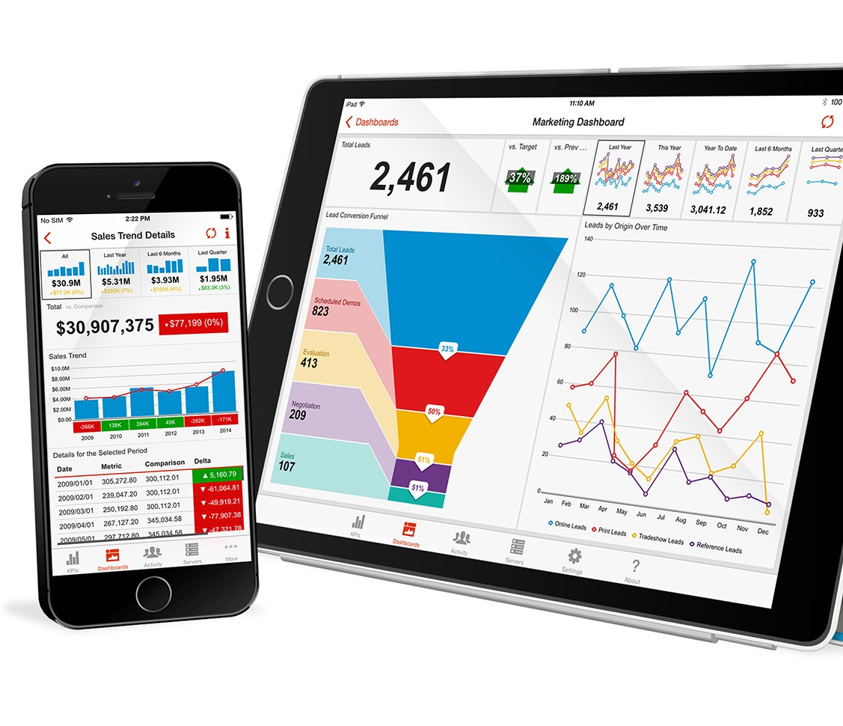
The new PowerBI

Slide 21
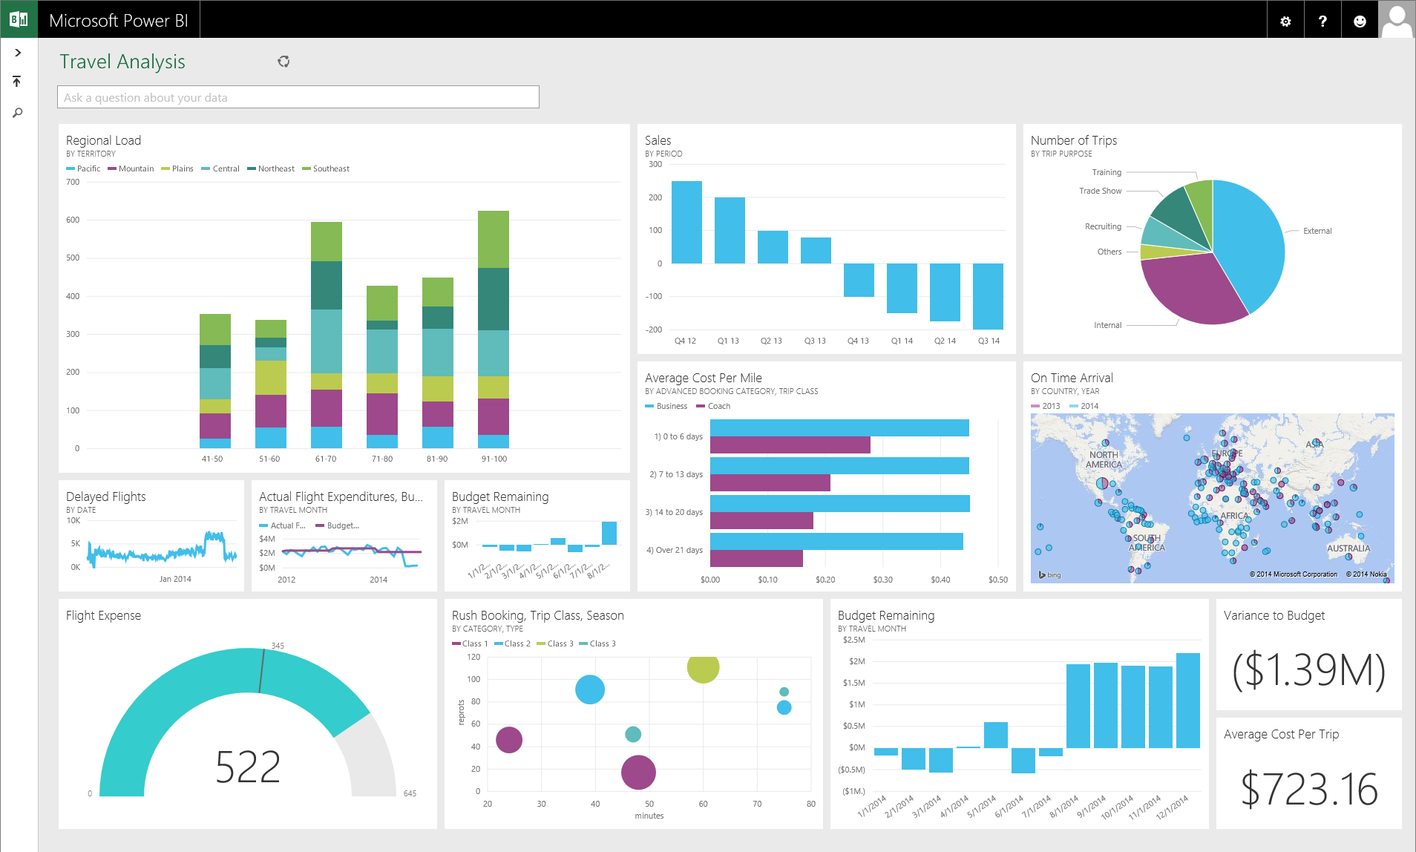
See all your data in a single pane of glass Live dashboards and interactive reports
Dashboards
Monitor live dashboards for the data that matters most
Track your data in real-time with support for streaming data
Drill through to underlying reports to explore and discover new insight
Pin new visualizations and KPIs to monitor performance

Slide 22
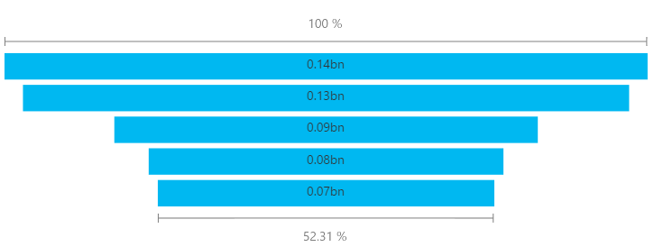
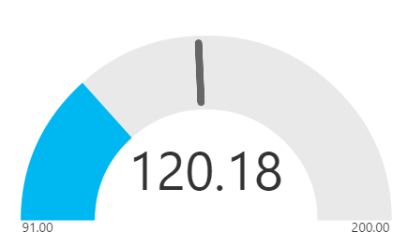
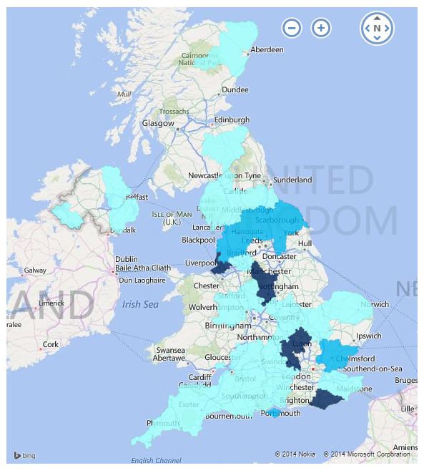
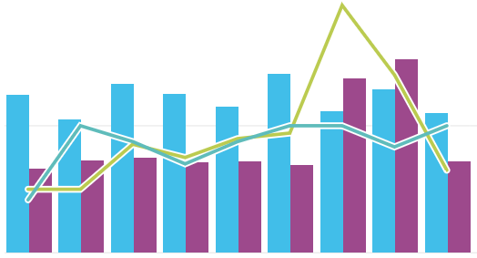
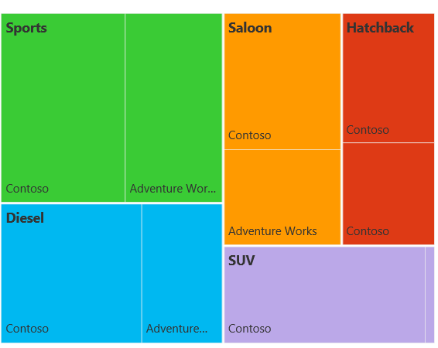
Visualize your data in new ways New Power BI Visualizations
Funnel
Gauge
Fill Map
Combo Chart
Tree Map

Slide 23
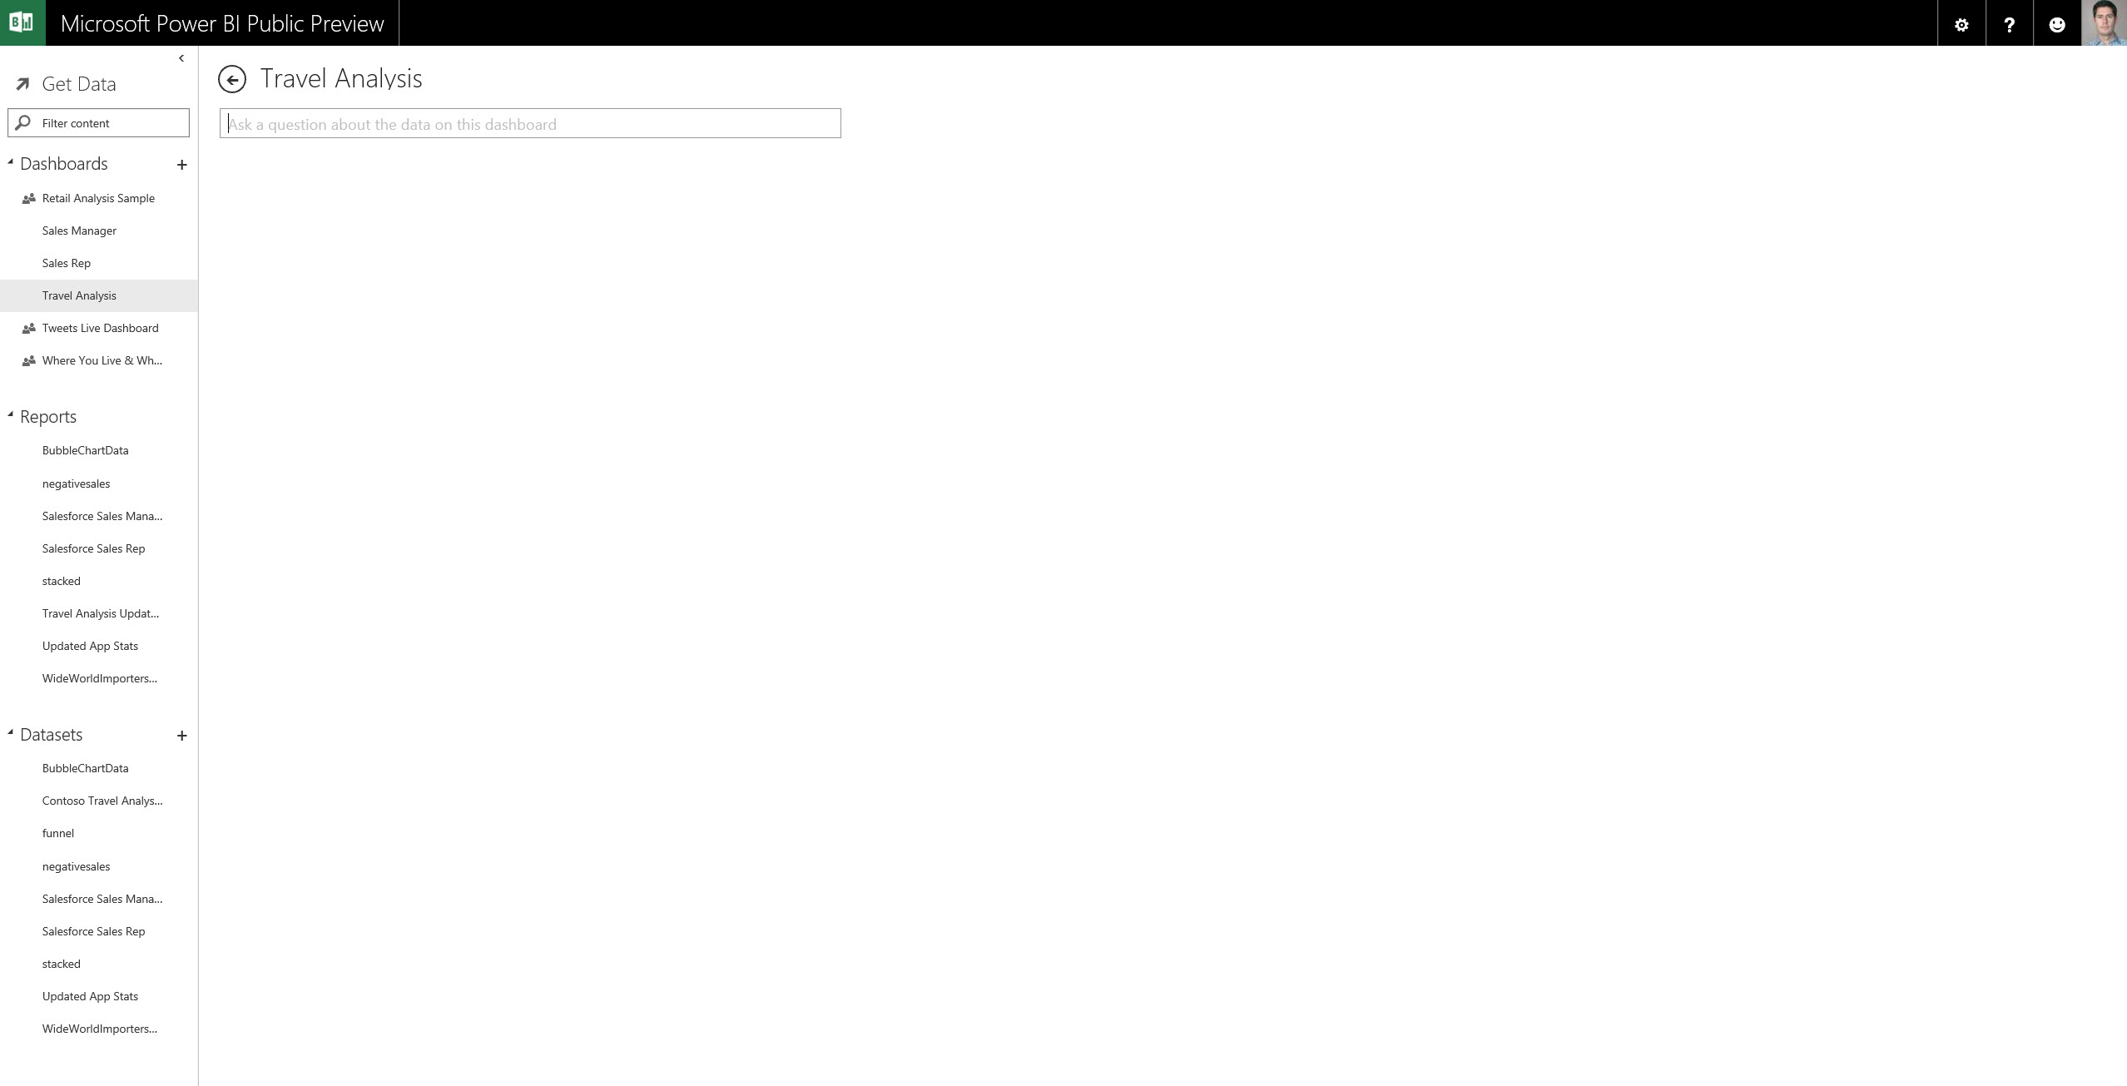
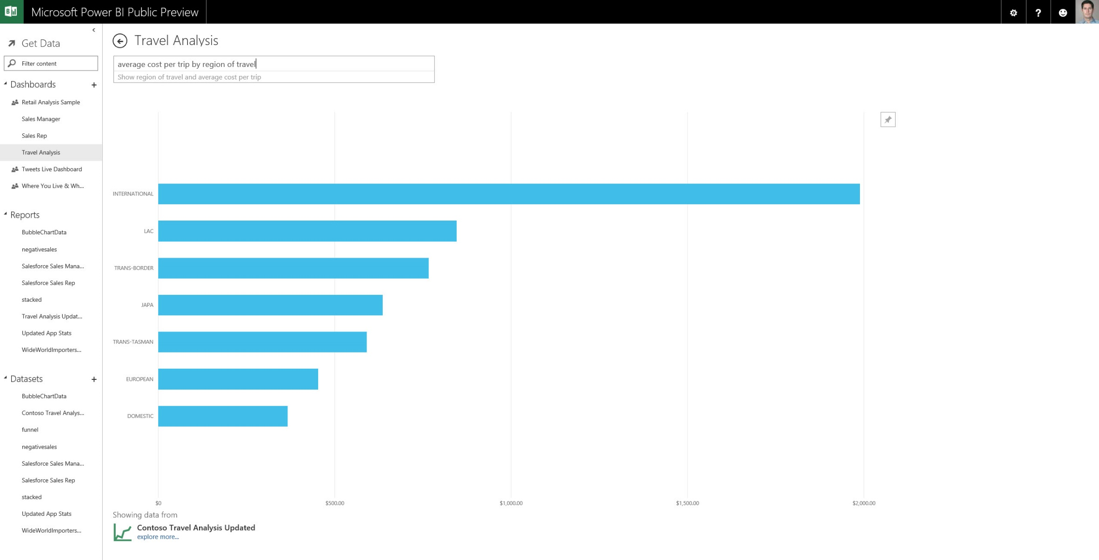
Ask questions of your data Natural Language Query
Ask a question about the data on this dashboard
What is the average cost per trip by region of travel?
Type a question and Power BI gives you the answer

Slide 24
Power BI dashboards

Slide 25








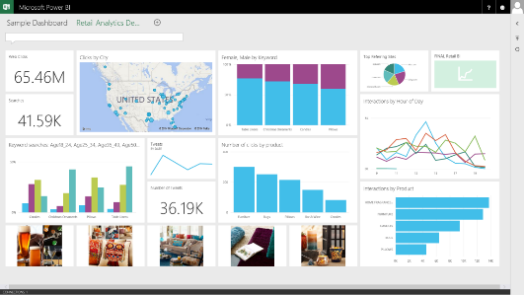


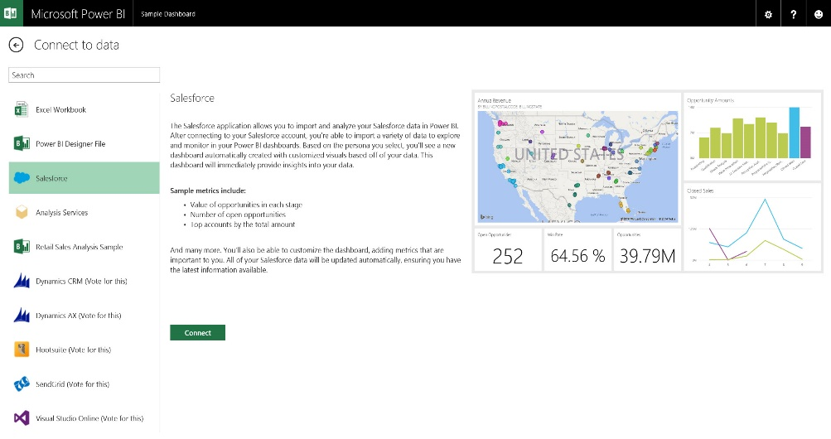
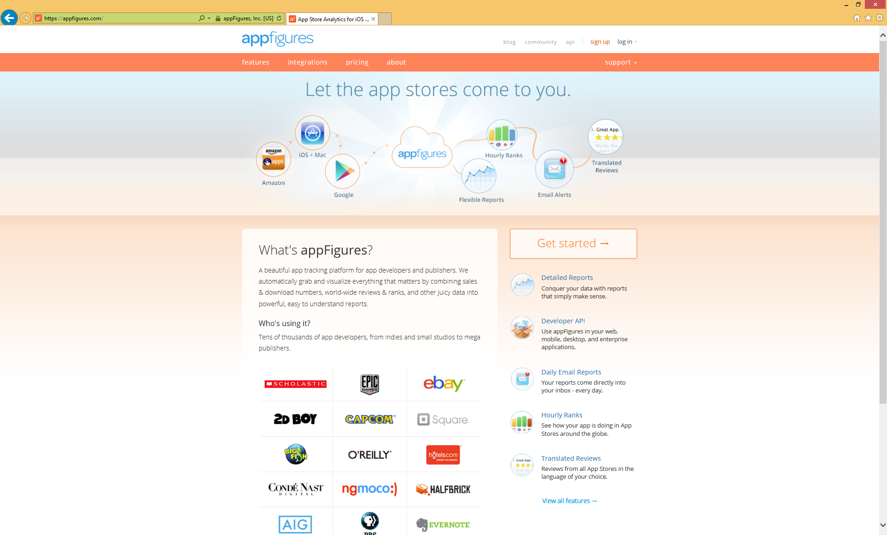












Get started quickly Prebuilt content packs for popular services
TODAY
Dynamics Marketing
COMING SOON
* Some solutions not yet available in preview

Slide 26
Power BI content packs

Slide 27
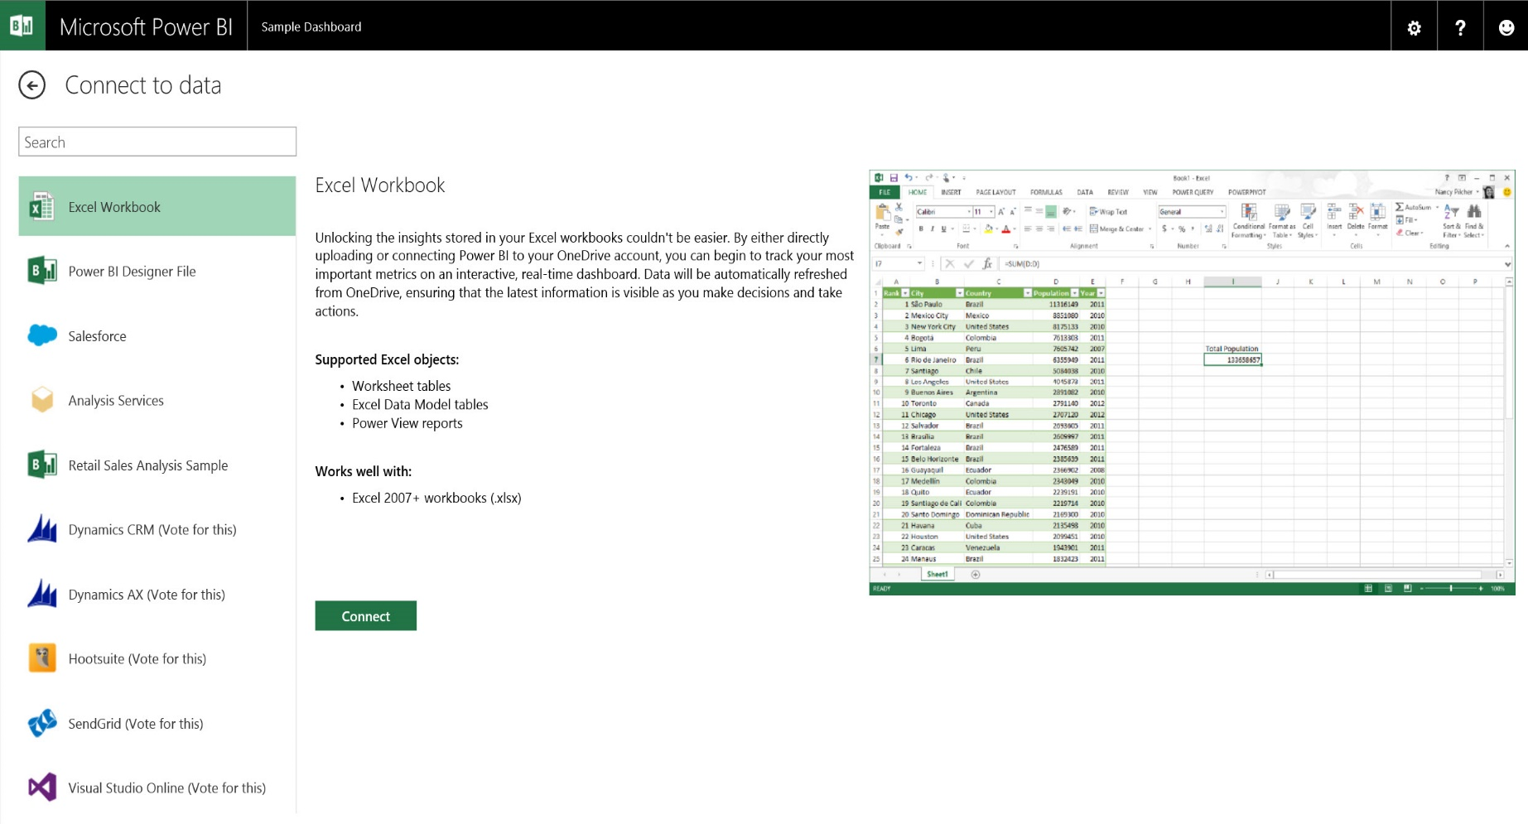
Unlock your Excel data Publish your Excel workbooks to Power BI
Analyze your data in the familiar Excel environment
Share Excel data, analysis, and reports in Power BI
Connect live to Excel workbooks in OneDrive

Slide 28
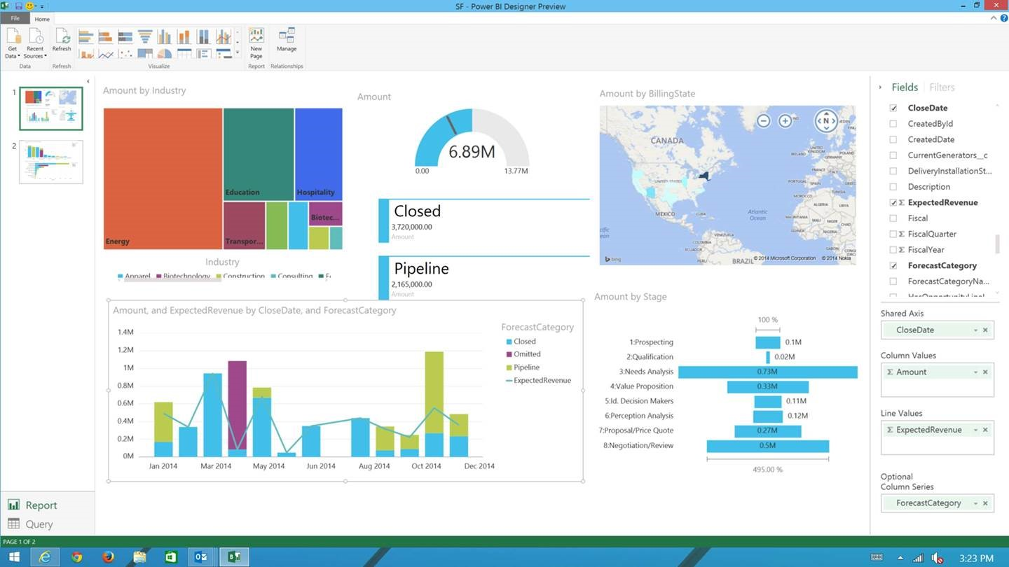
Create Power BI Content Visual Data Exploration & Interactive Reporting
Power BI Designer
Desktop companion for the Power BI service
Visually explore your data and create interactive reports
Effortlessly publish and share with users of Power BI

Slide 29
Power BI Designer

Slide 30
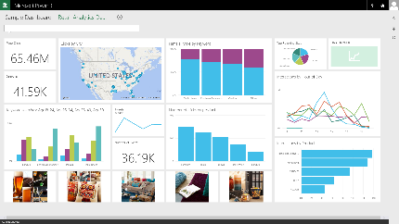
Connect to on-premises data Live Query & Scheduled Data Refresh
Live Power BI reports & dashboards
Faster time to insight with a hybrid BI solution
Manage and secure data on-premises with SQL Server Analysis Services
Optimized query performance for interactive exploration
Scheduled refresh of data stored in Power BI
Live Query
Scheduled Refresh
Cloud
On-premises
SQL Server Analysis Services
Data Source

Slide 31
Power BI live connectivity to SQL Server Analysis Services

Slide 32
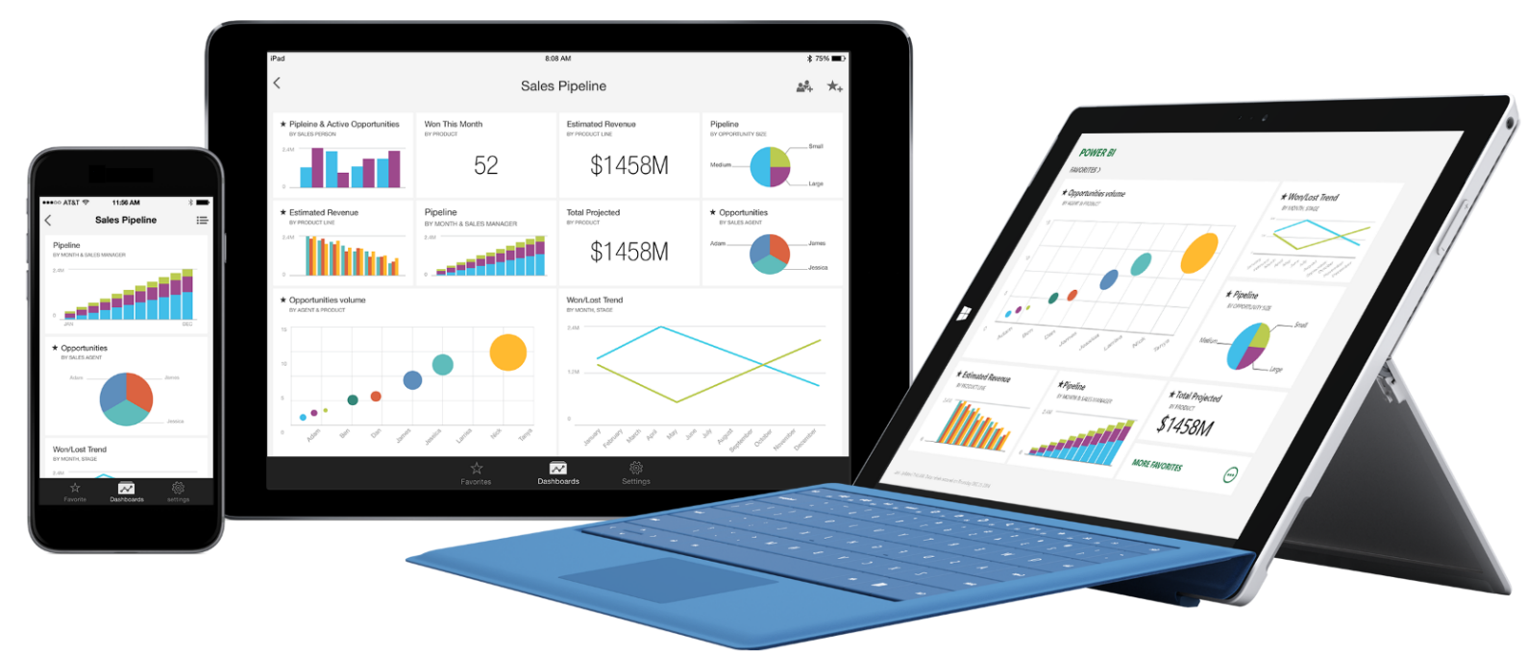
Stay connected from any device
Native apps for iPad, iPhone, and Windows devices
Receive alerts to important changes in your data
Share and collaborate with colleagues and take action

Slide 33
Power BI mobile apps

Slide 34

Metro Bank
“We go live with mobile banking, and in less than a week we have a full business intelligence suite to track it. It’s pretty cool. Power BI was instrumental in this.”
Bruce Rioch Head of Business Information and Customer Systems

Slide 35
Q&A

